Slide 1
Mary Bridge Children’s Neurology
Epilepsy Training for School Nurse
Tanya Hammer RN BSN
Mary Bridge Children’s Neurology

Slide 2
EPILEPSY
WHAT IS A SEIZURE?
A seizure is an abnormal electrical discharge of a group of brain cells.
Seizures can produce a variety of symptoms, depending on the location of
the seizure focus and the spread of the electrical activity through the brain

Slide 3
WHAT IS EPILEPSY?
A person has epilepsy when he/she has more than 1 one epileptic seizure.
Who has seizures?
About 10% of all people will experience a single seizure during his/her lifetime.
Who has epilepsy?
About 3% of Americans will have epilepsy in their lifetime.
About 1% of children have epilepsy.

Slide 4
What Causes Epilepsy?
There are many different causes of epilepsy.
In children the most common cause is genetic.
Other causes include head trauma, abnormalities in brain development, infections, brain tumors and others.

Slide 5
Etiology (Cause) of Epilepsy in Children <15 Years of Age

Slide 6
TRIGGERS OF SEIZURES
The following conditions can trigger a seizure:
  Forgetting to take medication
  Lack of sleep
  Stress
  Menstruation
  Concurrent Infection like flu or fever
  Alcohol or drug use

Slide 7
IS EPILEPSY CONTAGIOUS?
NO!

Slide 8
TYPES OF SEIZURE
Focal Seizures
Generalized Seizures

Slide 9
Focal Seizures
  Affect one part of the body
  Sensory, motor or visual disturbances
  May remain conscious throughout
  Can also lead to loss of consciousness
  May start as a focal seizure and spread throughout the whole and result in a generalized seizure.

Slide 10
Generalized Seizures
There are several types depending on the symptoms.
The most common are:
Generalized Tonic Clonic generalized stiffening and jerking convulsive activity
Atonic seizures include a sudden loss of body tone and may result in falling
Tonic seizures include a sudden stiffening of the body.
Myoclonic seizures include a sudden jerk of the body.
Absence seizures (Petit Mal) includes staring spells..

Slide 11
Tonic Clonic
There is almost always a loss of consciousness (30 sec -5 minutes)
General muscle contraction (Tonic phase) or violent rhythmic contraction and relaxation (Clonic phase) lasting 1-2 minutes.
May exhibit tongue biting, incontinence, difficulty breathing .

Slide 12
Epilepsy Syndromes
There are many Epilepsy Syndromes.
Some are mild and outgrown, and some are devastating lifelong conditions. Some of the most common are:
BECTS (Benign Rolandic Seizures)
Panayiotopoulos Syndrome
Childhood Absence SYndrome
Juvenile Myoclonic Syndrome
Doose Syndrome
Dravet Syndrome
Lennox Gastaut Syndrome
West Syndrome

Slide 13
Nonepileptic Seizures
Pseudoseizures/ Conversion Disorder

Slide 14
A mental health event that can appear like an epileptic seizure, but has no change in electrical energy.
It is usually in response to trauma, and requires careful assessment and prolonged mental health treatment.
Often appears like a dramatic seizure, may be prolonged, with variable manifestation.
A Video EEG is the only way to definitively diagnose nonepileptic seizures.
It is possible for a person to have both Epileptic and Nonepileptic seizures.
Epileptic Seizure usually presents the same way every time.
Nonepileptic seizure can present differently, and have incompatible symptoms. (GTC while still responsive and talking) .
Please call the neurology clinic to discuss them, and ask for EAP
Emergency Action plan that addresses both.

Slide 15
Epilepsy-Related Comorbid Conditions
Cognitive impairment
Depression
Injury
Sudden death
Endocrine dysfunction
Migraine
Sleep disorders

Slide 16
DIAGNOSIS
Epilepsy is diagnosed based on the information of events that happened during the attack, obtained from the patient and/or observers of the events.
The Neurologist may also order tests to help in the diagnosis.

Slide 17
Electroencephalogram (EEG)
This test is done to record the electrical activity of the brain and will take about 30-45 minutes of recording (one and ½ hour appointment).
During the test, many (sensors) electrodes are applied with paste to the patient's head.
The patient will also be asked to perform a few tasks to see if these activities activate epileptic seizures.
It is best if the patient can relax and fall asleep during the test.

Slide 18
Video Electroencephalogram (VEEG)
A stay in the hospital 24 hours or more that records brain wave activity while monitoring the child with a video camera then entire time.
The parent stays with the child and observes for behavior suggestive of seizure.
If the event occurs, parent pushes a button, and it makes a mark on the EEG recording strip. The parent describes the event so that the video recording picks up the audio description.
Neurologist interprets the EEG recording with the observed behavior on the video to determine if the behavior correlates with a change in electrical activity in the brain

Slide 19
Brain Scans
Computerized Axial Tomography
Magnetic Resonance Imaging

Slide 20
Computerized Tomography CT Scan
This scan uses computerized X-ray technology to produce pictures of the brain and may reveal structural causes of seizures.
But is typically done in an emergent situation.

Slide 21
Magnetic Resonance Imaging (MRI)
This is scanning of the brain uses a strong magnetic field, instead of X-rays to image the brain.
It is more sensitive in picking up subtle structural abnormality that could be the cause of epilepsy.
Some people may not be able to have an MRI Scan if they have some types
of metallic objects in their body.

Slide 22
TREATMENT
Anti-seizure Medications
Surgery
Diet Therapy
CBD

Slide 23
Anti-seizure Medications
Some patients with epilepsy may not require daily medications.
If treatment is warranted then medications are typically use for initial therapy.
There are many types of anti-seizure medications available.
The neurologist will discuss with patient and family the type of
medication that is best for the type of epilepsy.
Some patients have to take more than medication

Slide 24
If medications do not control seizures, or side effects are intolerable, then other treatments will be considered

Slide 25
Surgical Treatment
Brain Surgery
Patients with focal seizures not responding to anti-epileptic medication
might be suitable candidates for surgery depending on where their
seizures originate.
For those patients without a clear cut resectable lesion, Vagal Nerve Stimulation can be considered.

Slide 26
Vagal Nerve Stimulator
Implanted device that works as a “Pacemaker” for the brain
Runs 24/7
Has seizure detection capability
Magnet capability to abort seizure
Can prevent a seizure
Can stop a seizure
Can decrease seizure frequency , intensity and duration

Slide 27
CANNABIDIOL CBD
CBD has been used as a treatment for epilepsy.
Charlotte’s Web is probably the most famous strand
The Stanley brothers in Colorado developed the strain, originally known as “Hippie's Disappointment”. Charlotte Figgi, with Dravet Syndrome made it famous
Mary Bridge has a research project that has shown a lot of promise for children with Lennox Gastaut Syndrome, and Dravet Syndrome.
If a family wants to try CBD, we usually refer them to a Naturopath.
Vital Kids in Seattle has been helpful for many families

Slide 28
Diet therapy
Special diets can help some patients with epilepsy.
The ketogenic Diet (a diet very high in fat and low on carbohydrates)
Modified Atkins diet (high in protein and low on carbohydrates)
Low Glycemic Diet has shown to be effective (Boston Children’s Hospital)

Slide 29
SIDE EFFECTS OF MEDICATIONS
Common side effects include:
Sleepiness
Dizziness
Tiredness
Memory difficulty
Less common side effects include:
Hand tremor
Hair loss
Blurring of vision
Weight gain or loss

Slide 30
SEIZURE PREVENTION
AND PRECAUTIONS

Slide 31
Prevent Seizures by:
Remember to take anti-epileptic medications
Having sufficient sleep
Learning to relax
Avoiding alcohol

Slide 32
Seizure Precautions
Prevent injury
Avoid dangerous situations
Avoid triggers

Slide 33
WATER SAFETY IS #1
Caution with swimming, patients in swimming pools need continuous observation by someone that can help if they have a seizure.
A proper life jacket should be worn at all times when around other bodies of water (river, lake, ocean, etc.)
If bathing in a bathtub an adult needs to be present at all times to help if a seizure occurs.
Water temp <120

Slide 34
Avoid climbing where a seizure could cause a fall and could cause an injury.
Avoid opens fires, BBQ’s, cliffs.
Some patients with certain types of epilepsy can have seizures while playing computer/electronic games. (Photosensitive Epilepsy)
Medic alert bracelets, necklaces are recommended

Slide 35

Keeping a seizure diary is useful
Record the number of seizures
Evaluate efficacy of medications
Allow the doctor to titrate the medications Seizuretracker.com

Slide 36
Seizure First Aid
WHAT TO DO
RESCUE MEDS
VNS

Slide 37
WHAT TO DO WHEN SOMEONE
IS HAVING A SEIZURE

Slide 38
DO
Remain calm
Protect the person from harm
Turn the person to the side
Observe the type and duration of seizure

Slide 39
DO NOT
Restrain the person unless there is danger
Put anything in the mouth
Crowd around the person

Slide 41
Refer to student’s
Emergency Action Plan

Slide 42
Emergency Medication
The Neurologist may prescribe a medications to give if a child is having a seizure.
Diastat Rectal Gel
Intranasal Midazolam (Versed)

Slide 43
Diastat Rectal Gel

Slide 44
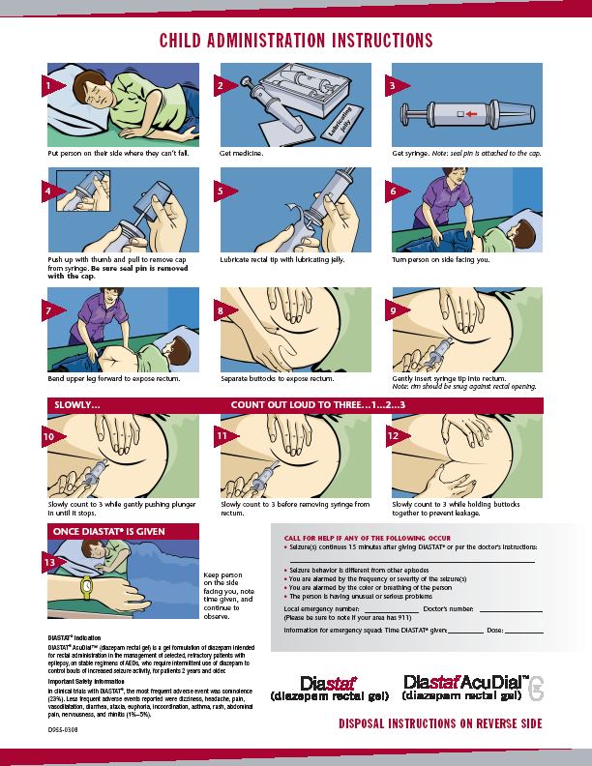

Slide 45
Intranasal Midazolam
Intranasal Midazolam
Drug Delivery Procedure

Slide 46
Delivery Materials:
Locking syringe
Blunt needle
Nasal Mucosal Atomizer device
Versed/midazolam medication at concentration of 1 mg/mL or 5 mg/mL

Slide 47
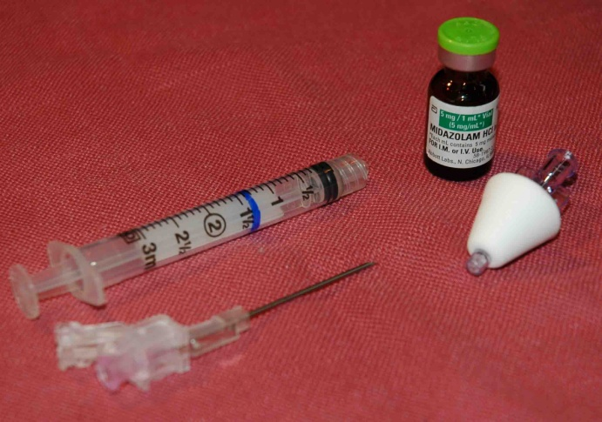

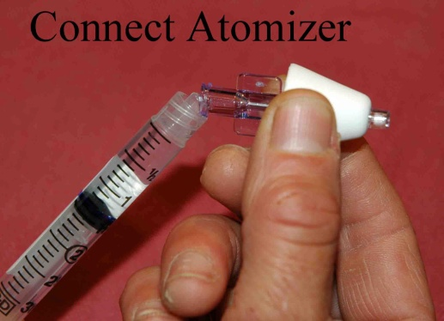
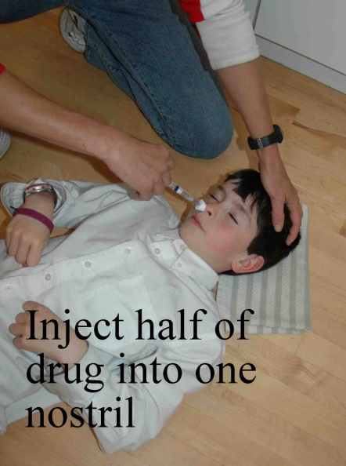

Slide 48
Pop the plastic cover off the medication vial (1 or 5 mL in each vial).
Twist the blunt needle onto the syringe and pull back to get some air in the syringe.
Put the blunt needle through the rubber stopper on the vial and push the air into the vial.
Pull back on the syringe to load with the dose of Versed/midazolam.
Twist off the blunt needle and dispose in an appropriate container.
Twist on the mucosal nasal atomizer.
Place atomizer firmly at the opening of the first nostril and briskly compress syringe to administer 1/2 of the volume as atomized spray.
Remove and repeat with other ½ in other nostril, so all the medication is administered.

Slide 49
Vagal Nerve Stimulator

Slide 50
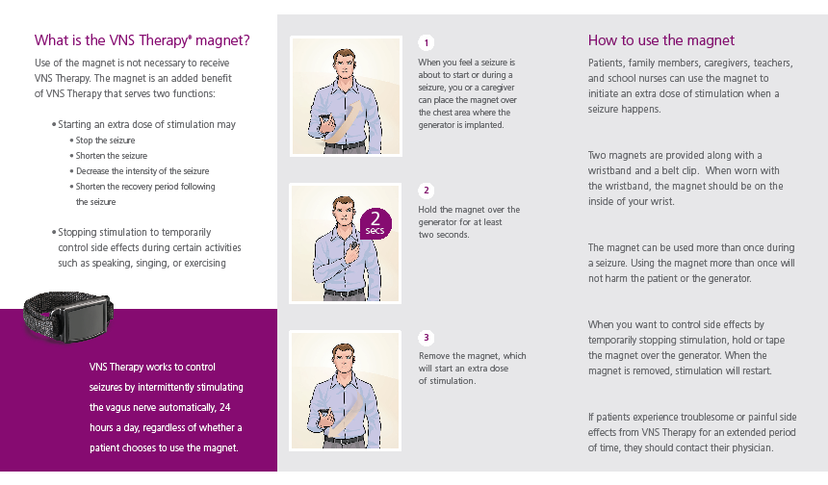

Slide 51


Slide 52
WHAT IS STATUS EPILEPTICUS?
Status Epilepticus is a condition when a person has:
Continuous seizures for more than 30 minutes; or
Seizures on and off for over 30 minutes, but without regaining consciousness in between seizures.
Status Epilepticus is a medical emergency, call 911.

Slide 53
Role of School Nurse in caring for student with Epilepsy
Emergency Action Plan and med orders
3 day supply and rescue med
Communicate with teachers and staff re health needs
Current health info in substitute teacher notebook
Academic Assessment. ADVOCATE for 504 Accommodations
Educate staff and students
Consider Epilepsy as a topic for Health class (very prevalent, though no one talks about it!)

Slide 54
Effect of Epilepsy on Memory and Learning
Seizure disorder(s) may impact learning in a variety of ways.
Memory and attention can be impacted during and after seizure for several hours.
Medication side-effects can impact many areas of learning such as alertness, memory, processing, attention, and behavior.
Many students report memory problems and cognitive fatigue.
The brain condition that leads to the seizure disorder(s) may also be associated with other learning disorders.
Children may also miss school and fall behind in school work due to doctor’s appointments, procedures and injuries sustained during seizure.

Slide 55
Suggested Accommodations for
Student with Seizures
The ability to work and/or take tests in a quiet environment with limited distractions.
A syllabus or homework packets to keep apprised of missed assignments.
A process for getting lecture notes from missed classes.
Shorter or modified homework assignments.
Provide alternative ways of receiving and demonstrating knowledge.
Extra time to make up assignments that are late or missed due to seizure/injury or side-effects of medications.
Extra time to make up missed exams without penalty.
Excuse all absences due to missing school because of a seizure, doctor or
procedure appointments or debilitating medication side-effects.

Slide 56
Communicating with
Mary Bridge Neurology
Clinic Phone Number (253) 792-6630
Tanya Hammer RN Personal Health Partner (253) 403-9370
Tanya.hammer@multicare.org
Please contact Tanya if you have concerns about a student’s seizures or learning challenges.
Tanya is willing to come to IEP meetings to provide education and clarification of student’s needs.

Slide 57
Resources
Epilepsy Foundation has a good website
Epilepsy Foundation has a training module for School Nurses
HOPE Mentors- through Epilepsy Foundation
Charlie Foundation- for Ketogenic Diet information
PAVE has good parent resources, and offers support groups
Parent Support Group meets monthly
Teen Epilepsy Group
Mary Bridge Clinic Nurses and Personal Health Partner

Slide 58
Thank you for caring for students with epilepsy!
They need your advocacy, compassion, patience, understanding, and teamwork!!

